Slide 1
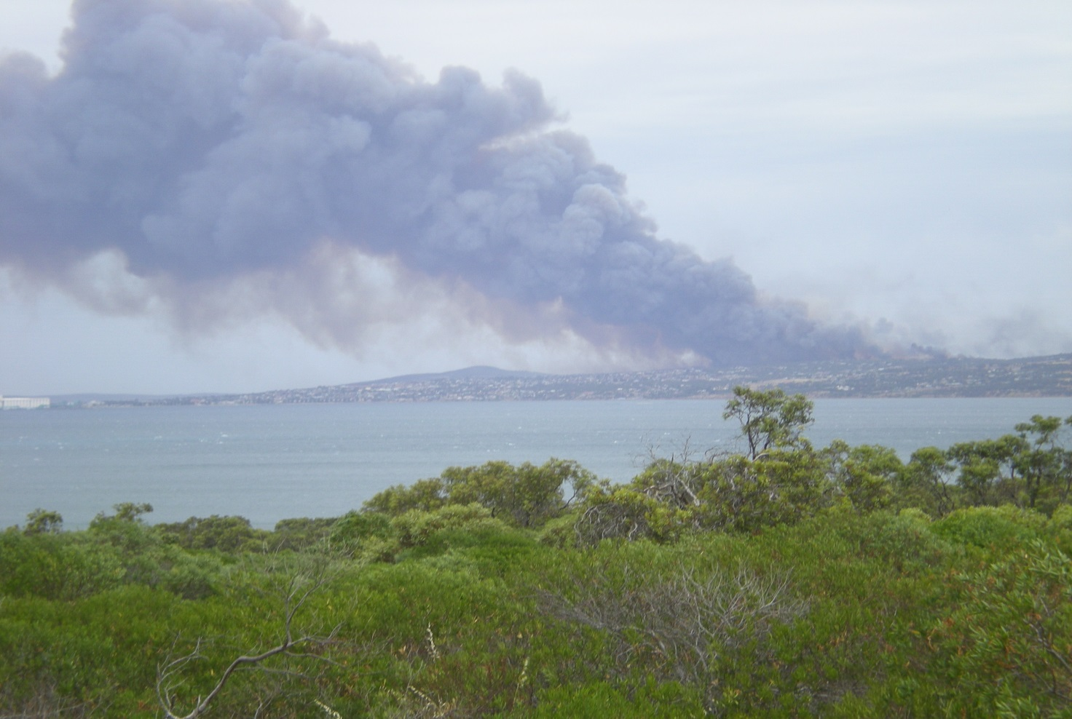
POINT BOSTON CC Inc. 25691
Port Lincoln Dec 2009
Photo taken from Point Boston WTF
Bushfire readiness Kit 2013

Slide 2
Point Boston Community Corporation Inc. 25691. Bushfire readiness Kit
IMPORTANT THINGS TO KNOW
You live in a MEDIUM fire risk area. Your home has been designed and built to either STAY & DEFEND or Leave.
If you choose to Stay & defend, implement your own Fire management plan. Guides to suitable plans are available from www.CFS.sa.gov.au
East Bay Precinct Bushfire Survival Plan template [insert link to Survival plan template document]
Your next-door neighbours home has the same fire safety measures in place as your home does
Defend your own property first
The community corporation inspects your property once a year to ensure your property is ready for the fire season
If you receive an order to make good your readiness you must make arrangements for that work to be undertaken.
Your home protection equipment is for mopping and clean up purposes only. It is not designed to fight a bushfire. The CFS will fight the fire.
The common property adjoining your property is managed by the community corporation well before the fire season
The community corporation maintains the Fire water supply in your street. Do Not interfere with these hydrants
The community corporation has negotiated with the local CFS to help defend your property. Do not interfere with the CFS operations
Your garden and plantings have been designed within the design guidelines of living within a Medium fire risk area.
It is your responsibility to maintain your external fire protection equipment so it is ready for use in a case of emergency.. Copy of the Deign guide lines are available from [insert link to the guidelines]
EMERGENCY ASSEMBLY POINTS ON THE BEACHES

Slide 3
Point Boston Community Corporation Inc. 25691. Bushfire readiness Kit
IMPORTANT THINGS TO KNOW
PBCP Guideline 4.5.6
Country Fire Service fire service tank connections: FIRE ENGINE RED
  Fire water tank: A dedicated 4,000 L non combustible tank for fire fighting purposes only shall be provided, in accordance with the CFS requirements and to the Minister’s Specification details.
  Colour: Paint fire service tank supply pipe work connection from the mains supplementary drinking water supply plumbing red in colour. Do not paint the tank or the CFS feed connection.
  The filling and level maintenance supply from the mains supplementary drinking water connection shall be as detailed in Section 4.5.3. of the plumbing guide
  Fittings: Plain brass/bronze/stainless steel - 1 x 65mm nominal bore London round thread rigid feed CFS tank connection. Install a hatch in the tank cover for access by CFS personnel. Install a tank contents indicator visible from the street and the house.
  Pipes exposed to view and above ground: Medium galvanized steel painted red.
  Supply stop valve: Required to have its handle removed and the valve to be in the permanently open position. (The valve is to be closed only during fire tank maintenance.)
  Overflow pipe: To have an inspection port as detailed in drawing House Allotment Water System Schematic included at the end of this guide.
  Signage: ‘WATER FOR FIRE FIGHTING’ on the side of the tank and ‘FIRE WATER SUPPLY—DO NOT DRINK’ in 100mm high white lettering on red background on the side of the tank adjacent to the London connection valve, obtainable from the Community Corporation. Above ground adhesive labels to be UV resistant.

Slide 4
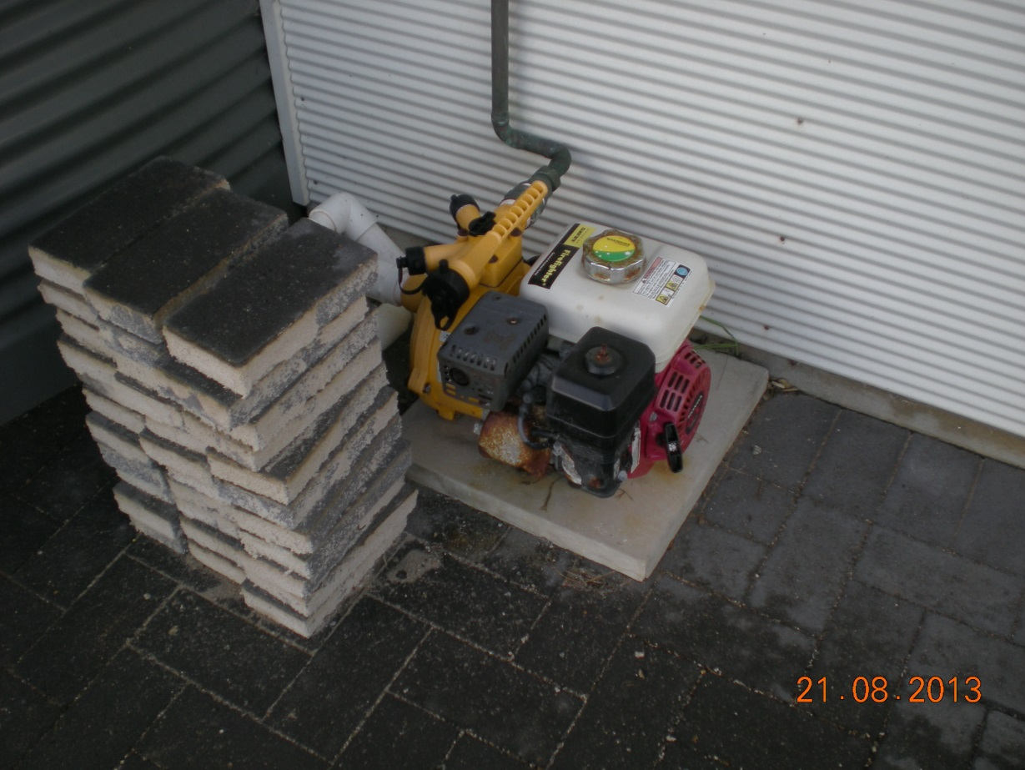
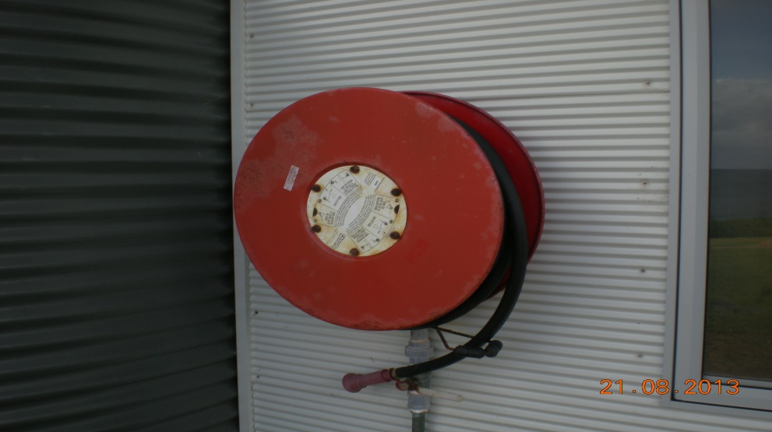
Home protection equipment External
5.5HP PETROL driven Fire pump
30mt long 19mm hose reel

Slide 5
Home protection equipment External
Add photo of a fire water storage tank showing London valve and signage
1000lt dedicated fire water supply
65mm London valve
Signage
Galv. pipe up-stand

Slide 6
Home protection equipment External
CFS Bushfire Survival action Plan [Add link to PB survival plan template]
Add PB Corporate management plan [Add link to PB corporate Bushfire management plan]
ADD link to native veg species list [Link to list)
CFS action plan
PBCC corporate management plan
PB native vegetation low combustion plant species

Slide 7
Home protection equipment Optional External
Add option photos
OPTIONAL EQUIPMENT
Roof mounted sprinklers
Window flushing sprinklers
Rakes, knapsacks, sand buckets etc.

Slide 8
Home protection equipment Internal
Optional
Add photos.
Internal fire extinguishers
Fire blankets
Protective clothing

Slide 9
ADDITIONAL INFROMATION
CFS ASSESMENT LETTER 4/04/2008 to be read in conjunction with the PB Design Guidelines Nov. 2009

Slide 10
ADDITIONAL INFROMATION
CFS ASSESMENT LETTER 2008
This statement does not comply with Dept. of Health approvals for Point Boston. Refer to PB Plumbing Guide for correct configuration

Slide 11
ADDITIONAL INFROMATION
CFS ASSESMENT LETTER 2008

Slide 12
ADDITIONAL INFROMATION
From: Dave Edwards [mailto:]
Sent: Thursday, 25 July 2013 1:24 PM
To: CFS:Building Fire Safety Unit
Cc: Point Boston Management committee
Subject: Non Combustible, Interpretation of the term when applied to selecting a material for fire water supply tanks
Hi Leah, thank you for your time today. The very simple question that has come from our Water Services Operation manager in Port Lincoln is;
What is meant by “Non Combustible” when describing a dedicated storage tank for a water supply for mopping up purposes at Point Boston?
There are a number of houses at Point Boston which currently have Team Poly tanks set up as the dedicated fire water supply for the property.
The development has been assessed at a Medium level. Does this assessment level have any influence on the tank material to be used?
Is the Australian standard AS 1530.1 you quoted the only measure used when determining the suitability of a particular type of tank?
We would like to minimise the number of types of tanks at Point Boston because the development is all about collecting water and reusing water.
In Trevor’s assessment letter he describes the use of the fire water being combined with the household water supply. This does not comply with the SA Health departments requirements to eliminate the risk of cross contamination.
The storage of that water is critical and quite obvious on the ground, 2 or 3 22,000lt tanks plus a 4,000lt dedicated fire water supply on each household lot.
The streetscape could get quite untidy if we don’t keep a control on the type and style of tanks that are used on the development.
Poly tank are an economical solution to the bulk storage of the water required at Point Boston.
To keep the dedicated fire water supply in the same type of tank is an ideal outcome.
A copy of the medium assessment is attached for your information.
I look forward to your support.
Kind regards
Dave Edwards
Question to CFS RE:
NON Combustible tank material 2013

Slide 13
ADDITIONAL INFROMATION
CFS INTERPRITATION OF
“NON COMBUSTIBLE” 2013

